Slide 1
FreelanceHub
Freelance Marketplace with Escrow Payments
A centralized platform for discovering freelance work and managing projects from proposal to completion.
Team Members:
2520030189-Akshaya
2520030211-Bhaarathi
2520030263-Madhan
Guide:Dr.S.Spandana | Department of CSE, KL University
Section-7
Batch-14
01

Slide 2
Project Overview
What the platform brings together
One workflow for two roles: clients who need work and freelancers who deliver it.
CLIENT
FREELANCER
Post work
Review proposals
Find work
Submit proposals
Clients publish project requirements, budgets, and deadlines.
Freelancers discover opportunities and submit proposals.
Clients review proposals and select a freelancer.
SHARED PROJECT WORKSPACE
The project is organized through contracts and milestones.
Contracts • Milestones • Messages • Reviews
Work approval and simulated escrow status are tracked.
END-TO-END PROJECT TRACKING
02

Slide 3
Problem Statement
Challenges across the freelance project lifecycle
Finding the right match
Unstructured coordination
Clients need to compare proposals; freelancers need relevant opportunities.
Requirements, deliverables, and deadlines can be difficult to follow.
Payment uncertainty
Fragmented records
Freelancers may face delayed payments; clients need an approval process.
Project updates, decisions, and transaction details may be spread across tools.
Project need: a centralized, traceable process for work, communication, and payment status.
03

Slide 4
Project Objectives
Designed around the needs of both sides of a project
Connect
Discover & apply
Agree clearly
Bring clients and freelancers into one marketplace.
Enable project browsing and proposal submission.
Record the selected freelancer and project terms.
Track delivery
Track payment
Build trust
Organize work into milestones with status updates.
Represent funding and release through simulated escrow.
Support profiles, reviews, messages, and dispute records.
04

Slide 5
Proposed System
A modular marketplace with a clear project lifecycle
Marketplace
Proposal management
Contract management
Create, browse, search, and view projects.
Submit a cover message, bid amount, and delivery estimate.
Keep the selected project terms and participants together.
Milestone tracking
Escrow tracking
Collaboration & feedback
Follow deliverables through pending, funded, submitted, and approved states.
Record simulated funding and payment release status.
Support messages, reviews, and dispute reporting.
The platform supports project coordination; escrow is a prototype simulation, not a real payment service.
05

Slide 6
End-to-End Workflow
From project posting to completion
01
Post project
02
Submit proposal
03
Select freelancer
04
Create contract
→
→
→
05
Fund milestone
06
Submit work
07
Review & approve
08
Release payment
→
→
→
Milestones can repeat for each deliverable; payment release follows the approval step in the simulated flow.
06

Slide 7
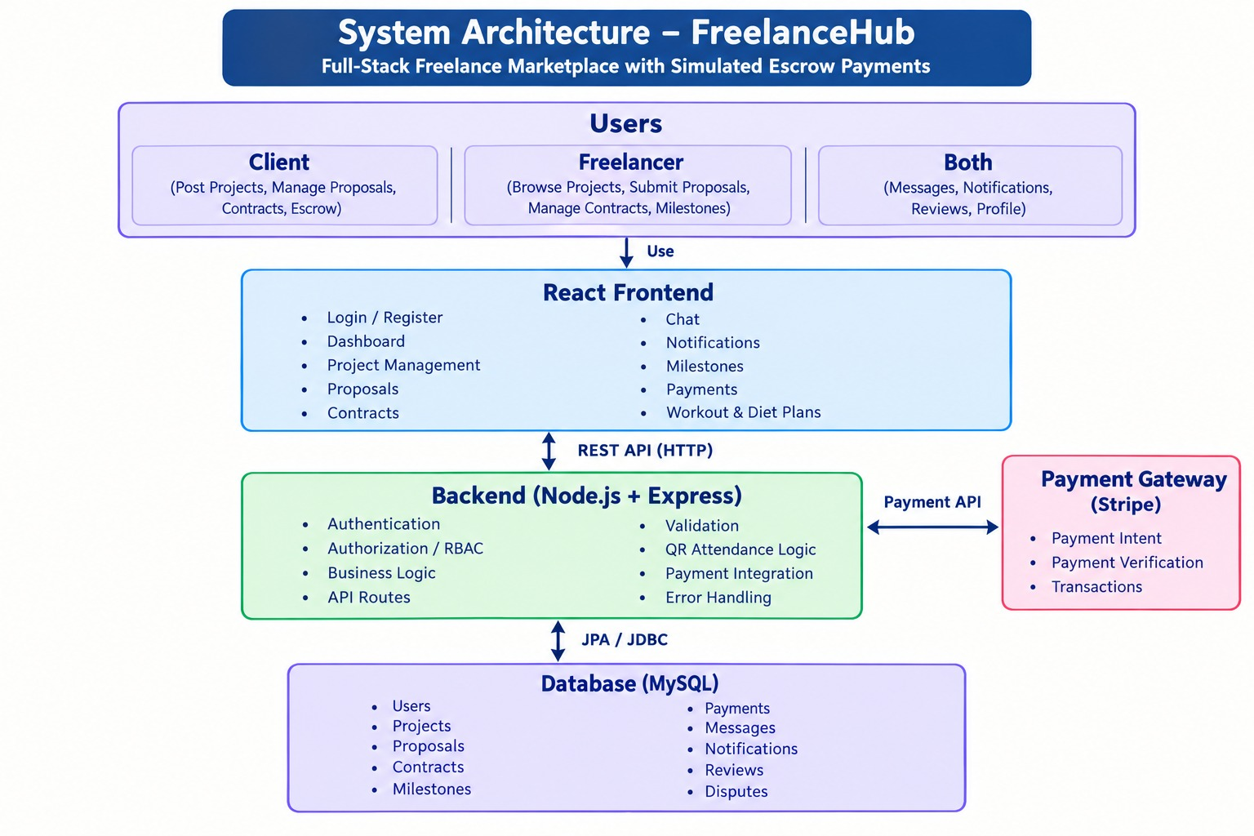
System Architecture
Logical flow of the web application
FRONTEND
↓
BACKEND
Node.js + Express • REST API routes and application logic
↓
STORAGE
JSON file • persistent application records • no MySQL
Request → API logic → JSON read/write → Response
07

Slide 8
Core Modules
Functional building blocks
Authentication & Users
Projects
Register, log in, roles, and profiles.
Create, browse, search, update, and cancel projects.
Proposals
Contracts & Milestones
Submit bids and manage proposal status.
Record agreements and track deliverables.
Payments
Messages & Notifications
Track simulated escrow funding and release.
Support user communication and updates.
Reviews & Disputes
Dashboard
Capture feedback and issue reports.
Summarize activity and project status.
08

Slide 9
Data Model
Main records used to organize marketplace activity
USER
PROJECT
Identity, role, contact details
Owner, title, description, budget, deadline, status
PROPOSAL
CONTRACT
Project, freelancer, bid, cover letter, status
Project, client, freelancer, terms, status
MILESTONE
PAYMENT / ESCROW
Contract, deliverable, due date, amount, status
Amount, linked contract/payment, status, release time
MESSAGE / REVIEW / DISPUTE
JSON storage keeps these records in a file for this prototype. It is not a relational database.
Communication, feedback, and issue records
09

Slide 10
Implementation & Validation
Demonstrate working flows with actual screenshots
Implementation areas
Suggested expo test sequence
Role-based client and freelancer flows
Log in with a demo client or freelancer
Project and proposal APIs
Create or browse a project
Contract and milestone records
Submit and review a proposal
Simulated payment status handling
Show contract and milestone status
Messaging, reviews, and disputes
Demonstrate simulated payment tracking
Insert real UI screenshots and Postman responses here
Only mark a feature as tested after confirming it works in your current build.
10

Slide 11
Technology Stack
Tools selected for the prototype
React.js
Builds the browser-based user interface.
Node.js + Express
Runs server-side logic and exposes REST endpoints.
JSON file storage
Persists prototype data without configuring MySQL.
Postman
Helps send requests and inspect API responses.
Git & GitHub
Support version control and source-code sharing.
Note: JSON file storage is suitable for a prototype; production deployment would need stronger persistence and security.
11

Slide 12
Conclusion & Future Scope
Summary and next development steps
Conclusion
Future scope
Connects clients and freelancers in one marketplace.
Integrate a real payment gateway.
Structures the path from project posting to delivery.
Add real-time chat and notifications.
Tracks proposals, contracts, milestones, and status.
Introduce skill-based project recommendations.
Includes simulated escrow tracking and collaboration features.
Improve identity verification and dispute workflows.
Develop mobile access and analytics.
THANK YOU • QUESTIONS?
12

